Slide 1




Detection of Cardiovascular Disease Using Machine Learning and Deep Learning
PULSEAI
Healthcare Systems |
Software Requirements Specification and System Design

Slide 2
TABLE OF CONTENTS
1.
2.
3.
5.
6.
7.
4.
Introduction
Database Design
Brief about Phase-1 Presentation
Software Requirement Specification
Project Architecture and Description
8.
FlowChart
Sequence Diagrams
Data Flow Diagrams
Database Table Structures

Slide 3

PULSEAI Introduction
Brief about Phase-1 Presentation

Slide 4
INTRODUCTION
Cardiovascular diseases (CVDs) remain one of the leading causes of death worldwide, accounting for millions of fatalities each year.
Early detection is vital to reducing mortality and improving patient outcomes. Among the most common diagnostic tools, the Electrocardiogram (ECG) plays a crucial role in monitoring and identifying heart conditions.
With the advancement of Artificial Intelligence (AI), particularly Machine Learning (ML) and Deep Learning (DL), the automation of ECG analysis has become a viable solution.

Slide 5
The proposed system, PULSEAI, aims to leverage both ML and DL techniques to detect cardiovascular diseases from ECG images. Unlike many existing solutions that rely solely on raw signals, PULSEAI processes image-based ECG data, making it suitable for diverse clinical environments. The system’s core contributions include:
An efficient model architecture optimized for low computational cost, ensuring compatibility with low-resource devices.
Automated and robust classification of multiple cardiovascular conditions, including normal rhythms, abnormal heartbeats, myocardial infarction, and history of myocardial infarction.
A comparative performance analysis between ML classifiers (e.g., SVM, KNN) and DL models to identify optimal solutions.
Real-time processing capability for immediate diagnostic support.

Slide 6
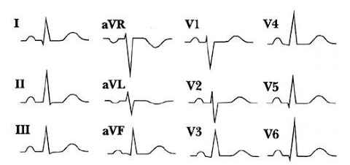
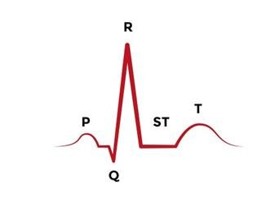
What is ECG?
An electrocardiogram (ECG) is a simple test that can be used to check heart’s rhythm and electrical activity.
12-lead Electrocardiogram(ECG)
Characteristics of ECG

Slide 7
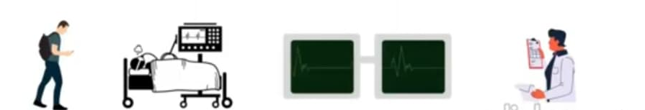
Why ECG Images for CVD Prediction ?
Digital technologies have revolutionized the signal analysis and automated diagnosis
Digitized ECG signals have advantages, such as security, easy to store, transmit and retrieve
It is essential to convert biomedical signals, such as ECG into digital form, for such computerized investigation
Existing System

Slide 8

Proposed System
Pros of Proposed System - PULSEAI
Without any delay, the results are instant.
Explainability: Shows grayscale, contours, per‑lead processing, 1D signals, PCA features—helps clinicians trust outputs.
Extensible to production: Can add auth (SSO), RBAC, MongoDB persistence, audit logs, and monitoring.
Cost-effective: Built on open-source libraries and standard tooling.

Slide 9
Dataset
ECG Images : https://www.kaggle.com/datasets/evilspirit05/ecg-analysis
We have used 4 categories CVDs ECG Images for image classification
Normal
Myocardial infarction
Abnormal Heart beat
History of Myocardial infarction

Slide 10

Software Requirements Specification
SOFTWARE REQUIREMENTS
HARDWARE REQUIREMENTS
Windows, macOS
Python 3.9
IDE:Visual Studio code
Jupyter Notebook
Streamlit(Python-based web UI) - Frontend
MongoDB Atlas
Chrome/Firefox
Python-dotenv
Google cloud
Git and Docker Desktop
CPU: Quad-core processor,
Dual-core intel i3 minimum
RAM: 8GB or more,
4GB minimum
Storage: 10+ GB SSD

Slide 11
Software Requirements Specification
✓
✗
Functional Requirements
Upload an ECG image via UI.
Visualize intermediate steps
Convert per-lead signal to scaled 1D numeric series and combine.
Apply PCA for dimensionality reduction.
Predict class via pre-trained model and display result.
Export intermediate artifacts (images/CSVs) to local working directory.

Slide 12
Software Requirements Specification
✓
✗
Non-Functional Requirements
Usability
Performance
Single-page, step-by step
feedback with expanders.
End-to-end prediction <10s
for typical images.
Hardware Optimized
Portability
Using only the CPU,
Without requiring
specialized hardware..
Runs locally (venv) or in Docker; deployable to Cloud Run.
Maintainability
Observability
Clear modular steps in Ecg.py.
Save intermediate artifacts for debugging.

Slide 13

Project Development Life Cycle
Requirement & Data Collection
Design (pipeline, UI, Model choice)
Implementation (Image processing, feature extraction ,PCA , model)
Validation and Deployment
Maintenance (Model updates, UI refinements, performance tuning).

Slide 14
SCHEDULE
Task | Description
Task 1 | Planning
Task 2 | Design and Prototyping
Task 3 | Development
Task 4
May 2025
June –July 2025
Aug – Sep 2025
Testing
Oct 2025
Task 5
Nov 2025
Deployment

Slide 15
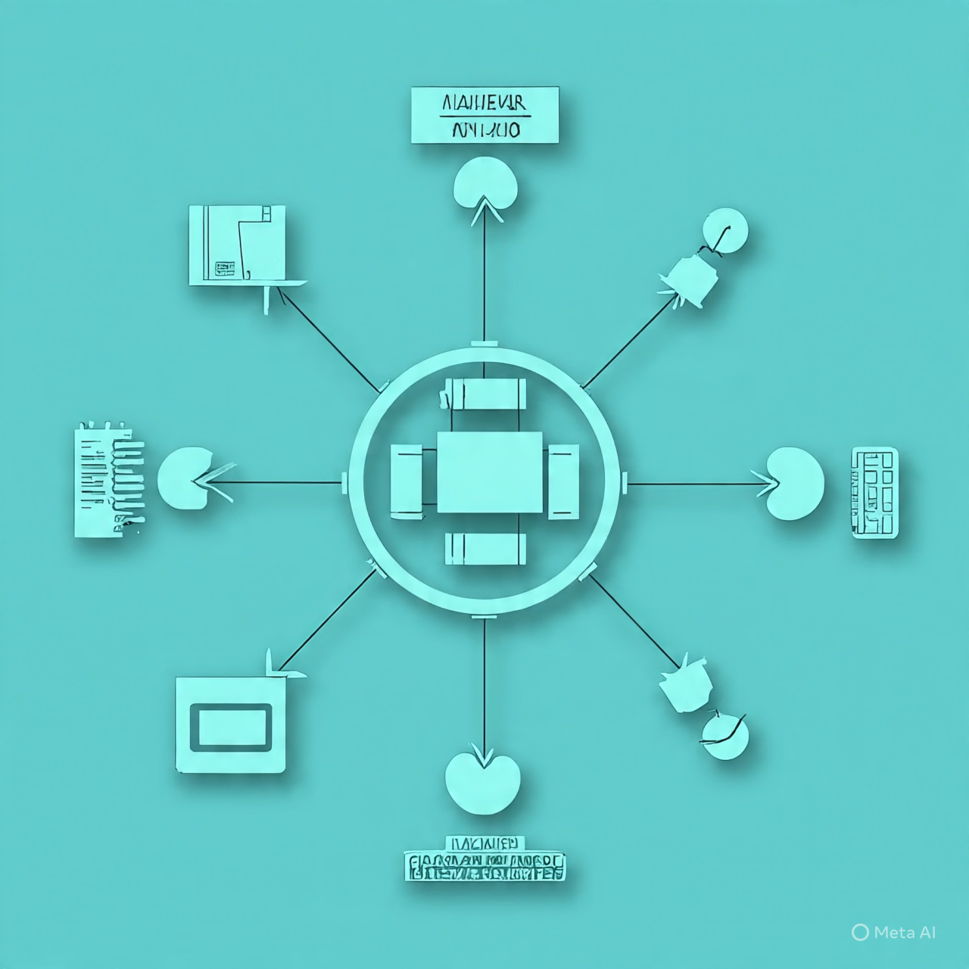
System Design

Slide 16
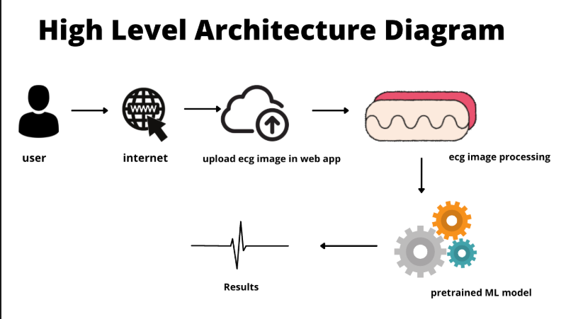
Project Architecture

Slide 17
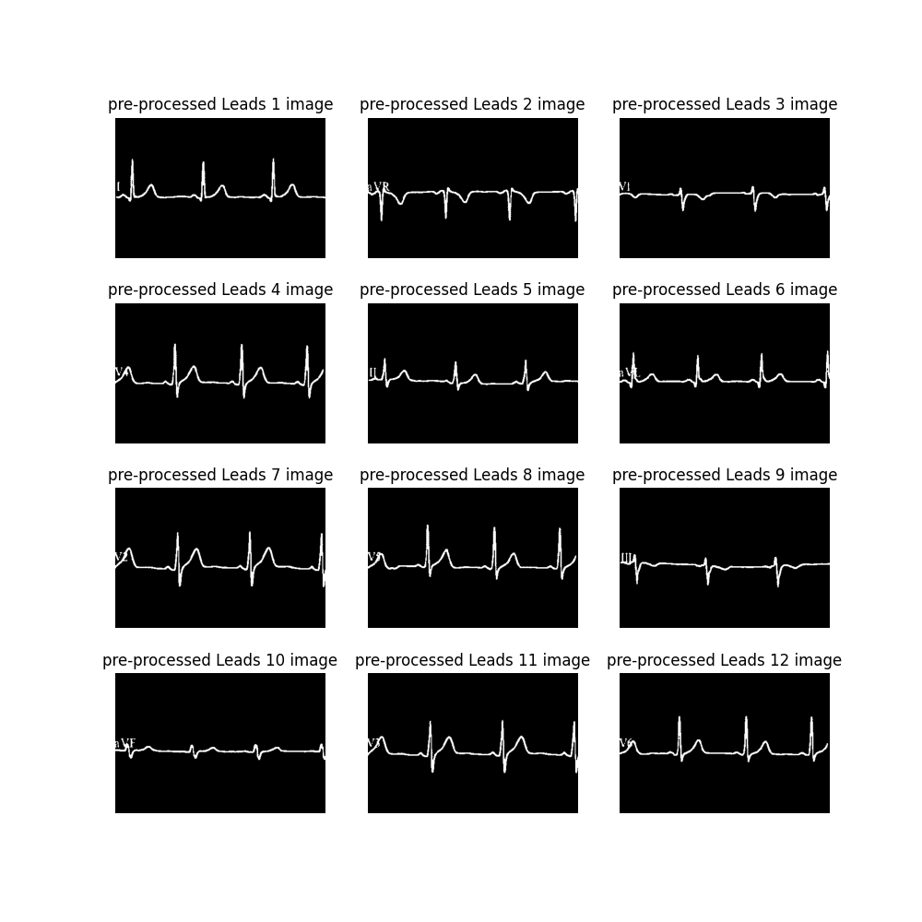
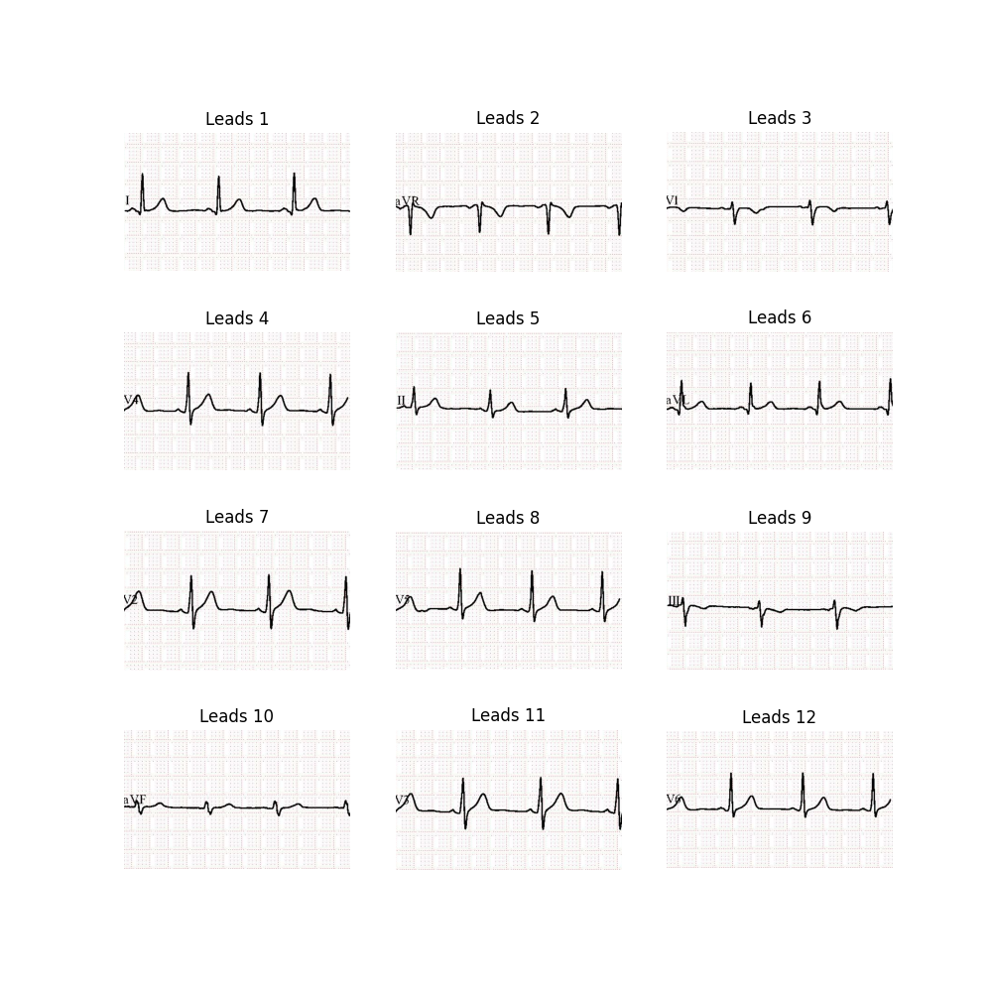
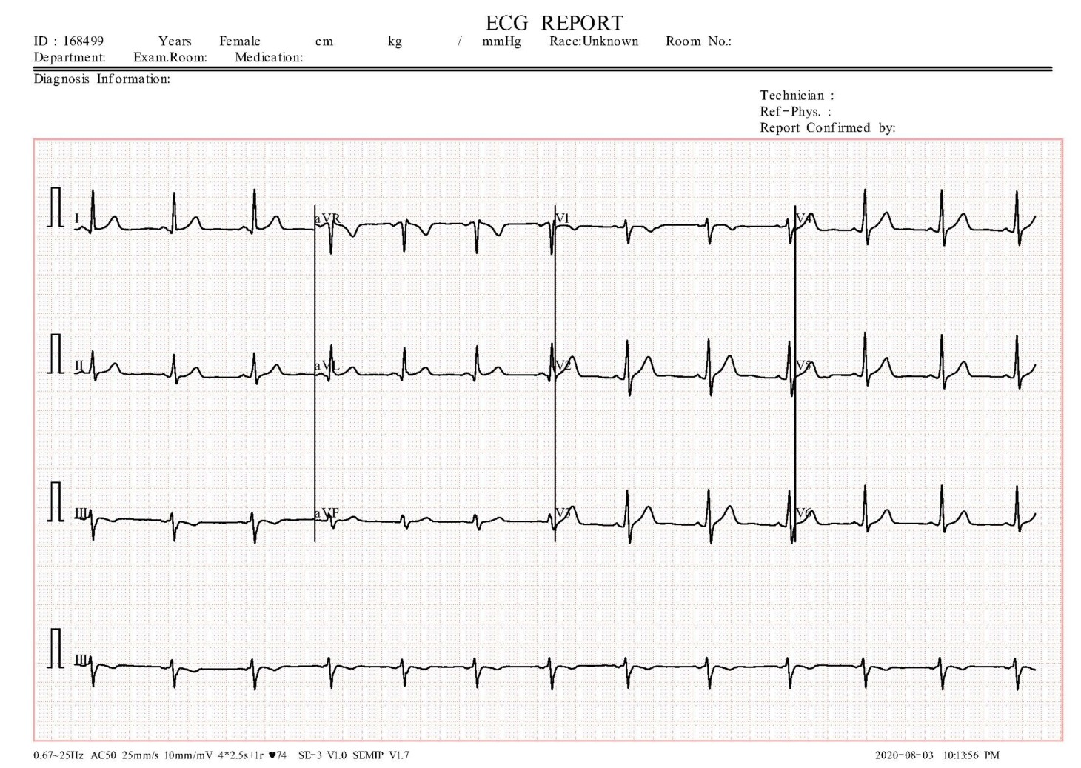
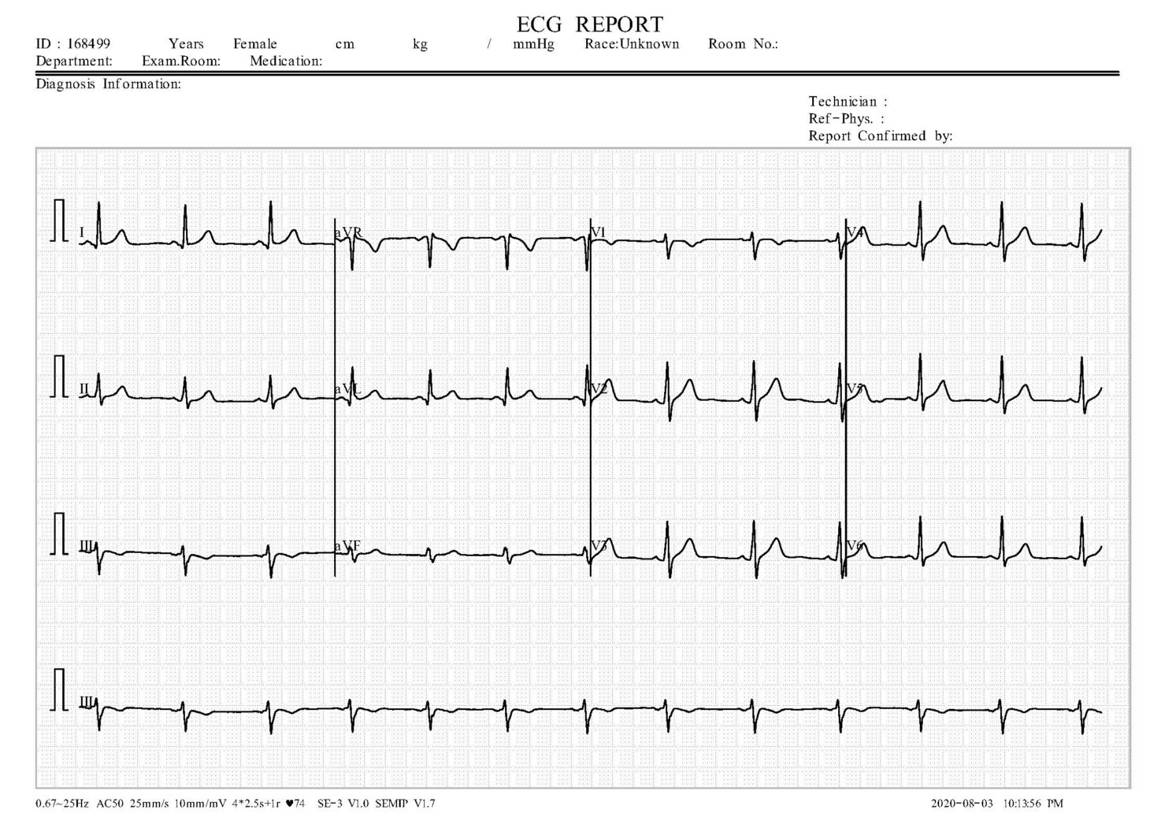
Data Preparation and Preprocessing

Slide 18
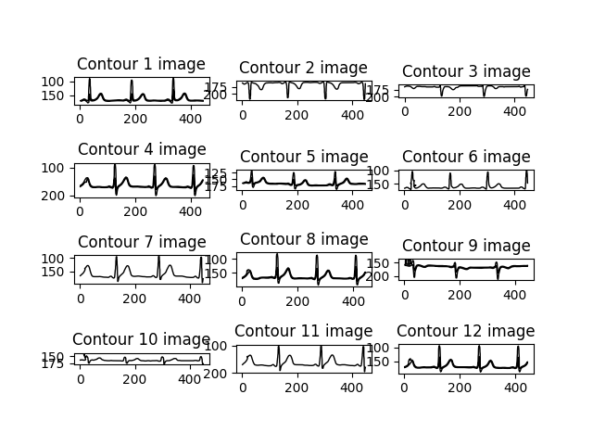
Data feature Extraction & Data Engineering
One combined csv file of 12 lead Signal values for processing
Multiple csv files with each lead values
Contour Signal for each lead(1-12)
Lead 1-12 values in separate csv file for all images

Slide 19
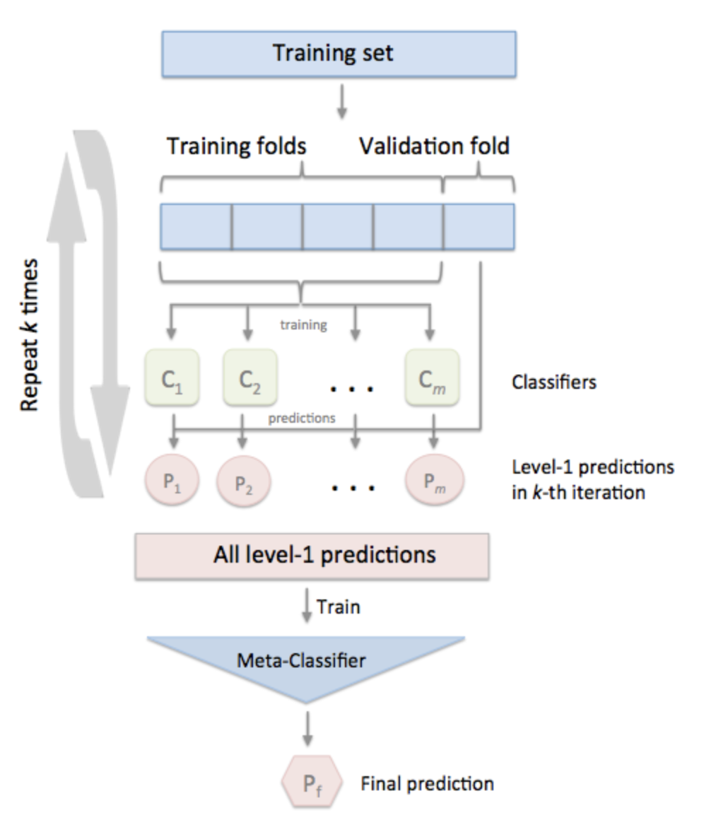
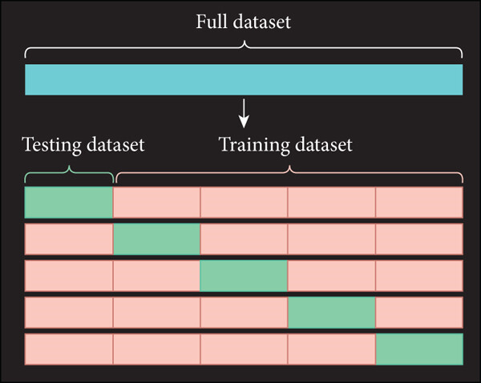
ML Model
Algos tested
GridSearchCV for hyperparameter tuning
Ensemble of stacking multiple models using voting classifier
KNN
Logistic Regression
SVM
Random Forest
GaussianNB
xgboost

Slide 20
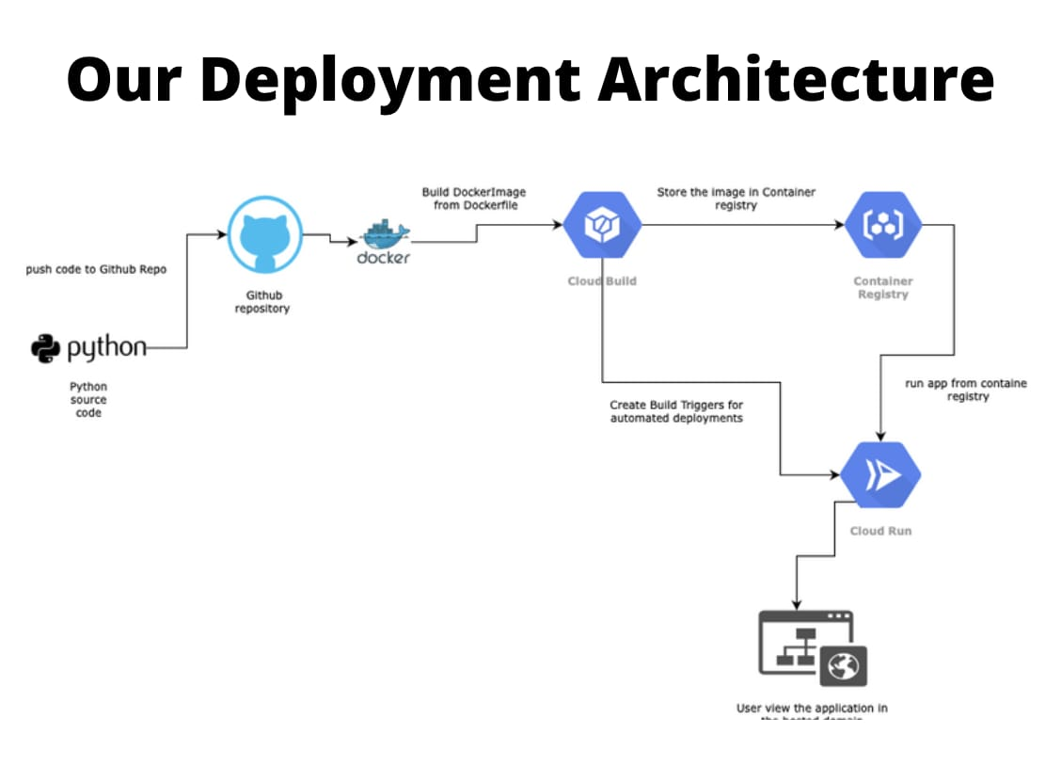
Project Architecture

Slide 21
Project Architecture Description
Layer / Component | Description
Application Layer | Streamlit app (Deployment/final_app.py) serves as UI & controller; users upload ECG images via st.file_uploader; expanders display each pipeline stage.
Processing Layer | ECG pipeline in Deployment/Ecg.py with functions: getImage, GrayImage, DividingLeads, PreprocessingLeads, SignalExtraction_Scaling, CombineConvert1Dsignal, DimensionalReduciton, ModelLoad_predict.
Model Artifacts | Joblib pickles stored in Deployment/ and model_pkl/; loaded on demand; CPU-only scikit-learn models.
Intermediate Storage | Artifacts like *.png and Scaled_1DLead_*.csv saved in the working directory for debugging and traceability.
Frontend/UI | Built with Streamlit components (st.image, st.expander, st.write); no separate SPA or API—Python functions directly drive the interface.
Dependencies / Runtime | Python 3.9 recommended; uses NumPy, SciPy, scikit-image, scikit-learn with pinned versions; runnable in local venv or Docker container.
Deployment | Cloud Run container exposing port 8080; local dev on port 8501 with the same entrypoint.

Slide 22
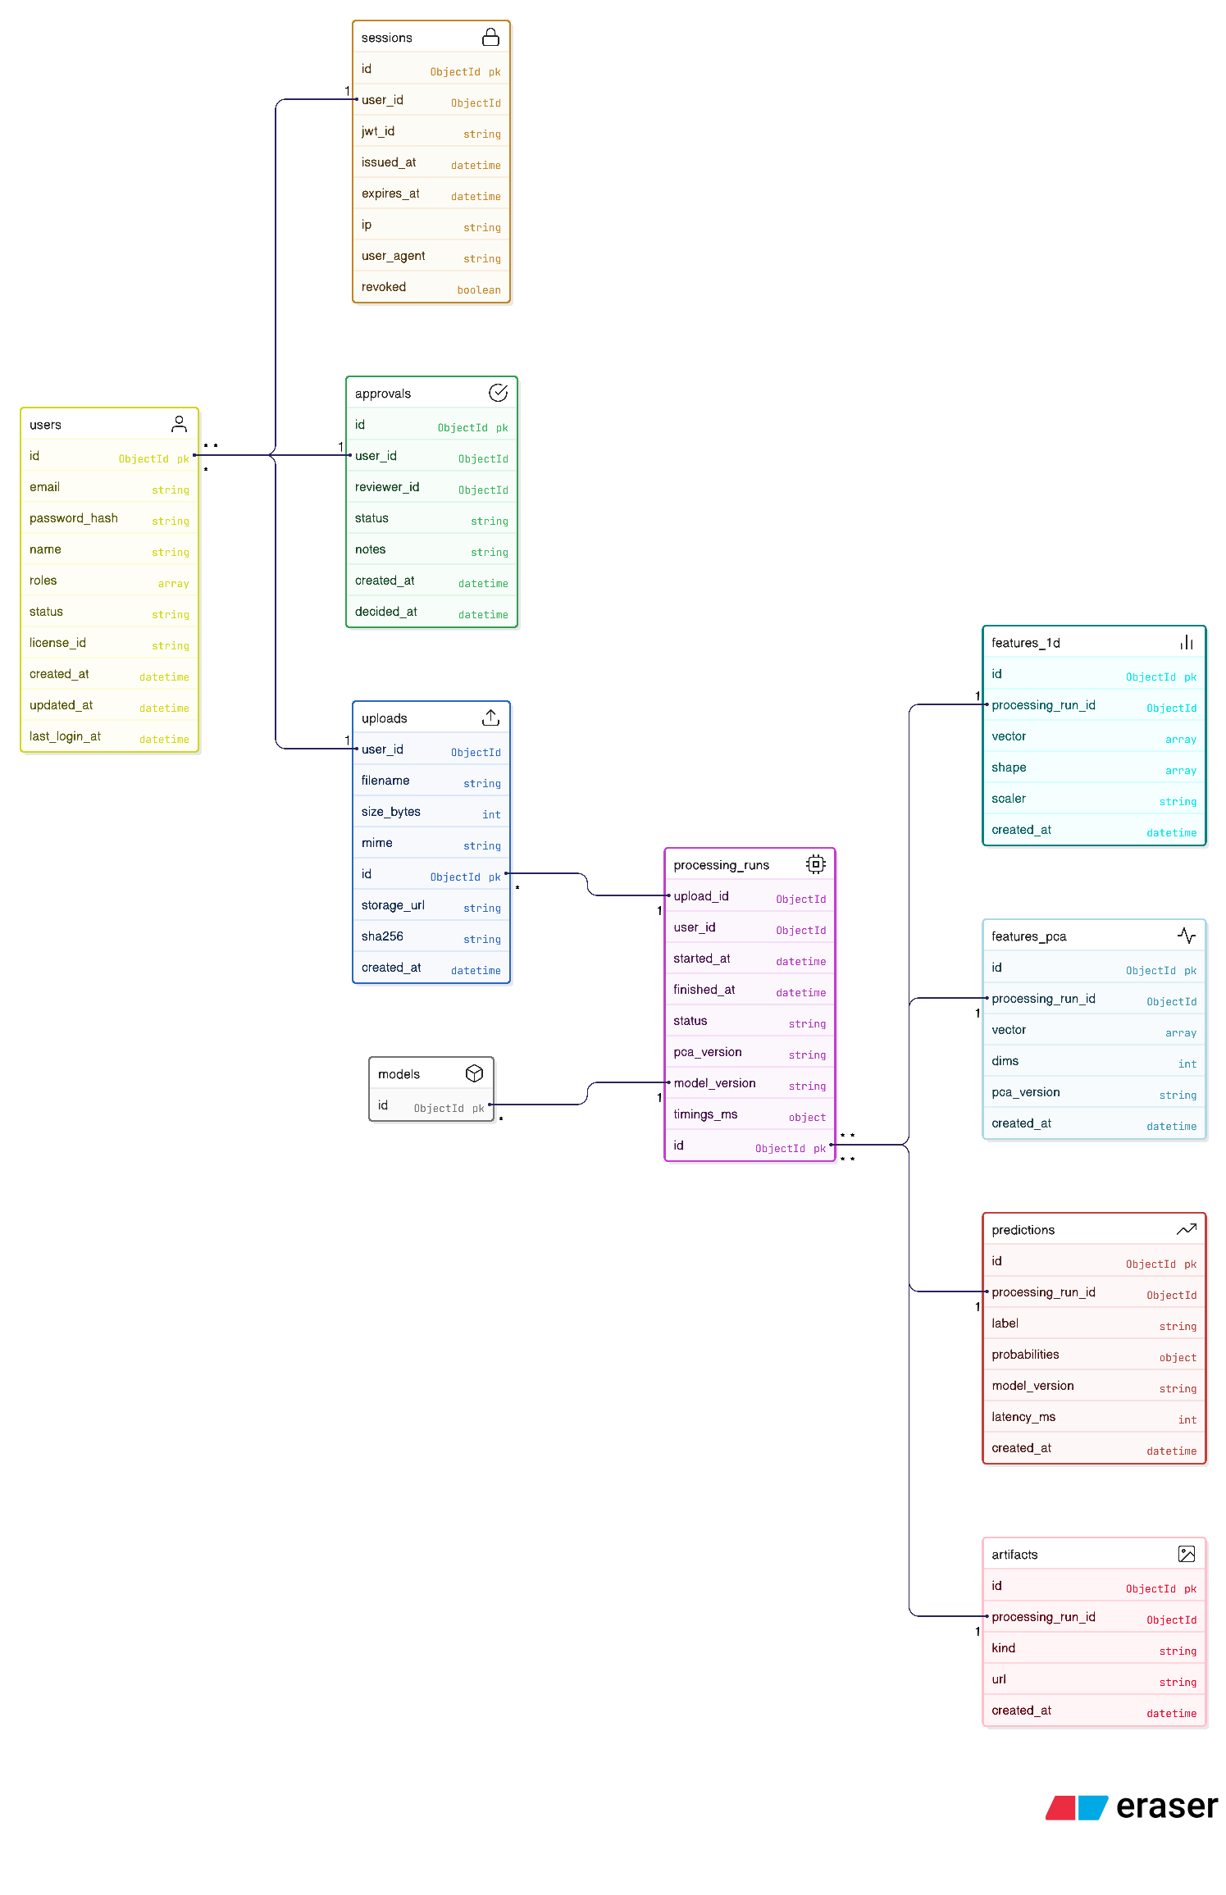
Database Design

Slide 23
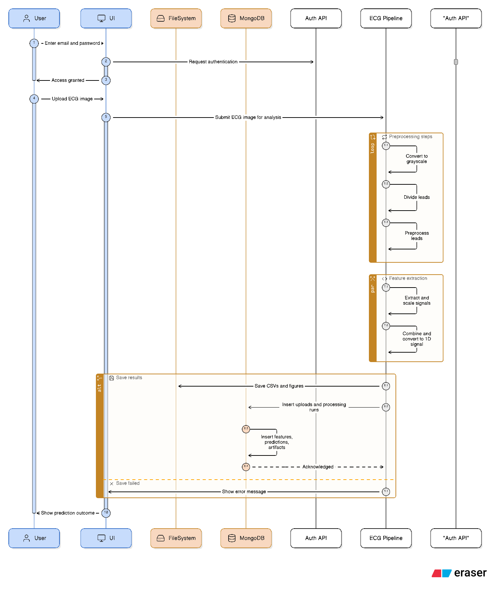
Sequence Diagram

Slide 24
Dataflow Diagram
Context:
External Entity: User
System: PulseAI Website
Database: MongoDB, Object Storage (images/artifacts)
Flows: Upload image, view results, stored artifacts/predictions

Slide 25
Dataflow Diagram
User
Upload & Read
Upload ECG Image
Preprocess
POST
Extract !D
PCA + Classify
Load Model + predict
MongoDB (Store Log)
Return result to User

Slide 26

Database Table Structure
1.Users Table
Column | Type | Constraints
id | SERIAL | PRIMARY KEY
email | VARCHAR(255) | UNIQUE, NOT NULL
password_hash | TEXT | NOT NULL
roles | TEXT[] | NOT NULL
status | VARCHAR(20) | NOT NULL

Slide 27
Database Table Structure
2. Session
Column | Type | Constraints
id | SERIAL | PRIMARY KEY
user_id | INTEGER | NOT NULL
jwt_id | VARCHAR(255) | UNIQUE, NOT NULL
expires_at | TIMESTAMP | NOT NULL

Slide 28
Database Table Structure
3.Uploads
Column | Type | Constraints
id | SERIAL | PRIMARY KEY
user_id | INTEGER | NOT NULL
filename | VARCHAR(255) | NOT NULL
storage_url | TEXT | NOT NULL
created_at | TIMESTAMP | DEFAULT now()

Slide 29
Database Table Structure
4. processing_runs
Column | Type | Constraints
id | SERIAL | PRIMARY KEY
upload_id | INTEGER | NOT NULL
user_id | INTEGER | NOT NULL
status | VARCHAR(20) | NOT NULL
pca_version | VARCHAR(20) | NOT NULL
model_version | VARCHAR(20) | NOT NULL

Slide 30
Database Table Structure
5. features_pca
Column | Type | Constraints
id | SERIAL | PRIMARY KEY
processing_run_id | INTEGER | NOT NULL
vector | FLOAT[] | NOT NULL

Slide 31
Database Table Structure
6. predictions
Column | Type | Constraints
id | SERIAL | PRIMARY KEY
processing_run_id | INTEGER | NOT NULL
label | VARCHAR(20) | NOT NULL
model_version | VARCHAR(20) | NOT NULL
created_at | TIMESTAMP | DEFAULT now()

Slide 32
Database Table Structure
7. predictions
Column | Type | Constraints
id | SERIAL | PRIMARY KEY
processing_run_id | INTEGER | NOT NULL
label | VARCHAR(20) | NOT NULL
model_version | VARCHAR(20) | NOT NULL
created_at | TIMESTAMP | DEFAULT now()

Slide 33
Database Table Structure
8. approval
Column | Type | Constraints
id | SERIAL | PRIMARY KEY
processing_run_id | INTEGER | NOT NULL
label | VARCHAR(20) | NOT NULL
model_version | VARCHAR(20) | NOT NULL
created_at | TIMESTAMP | DEFAULT now()

Slide 34
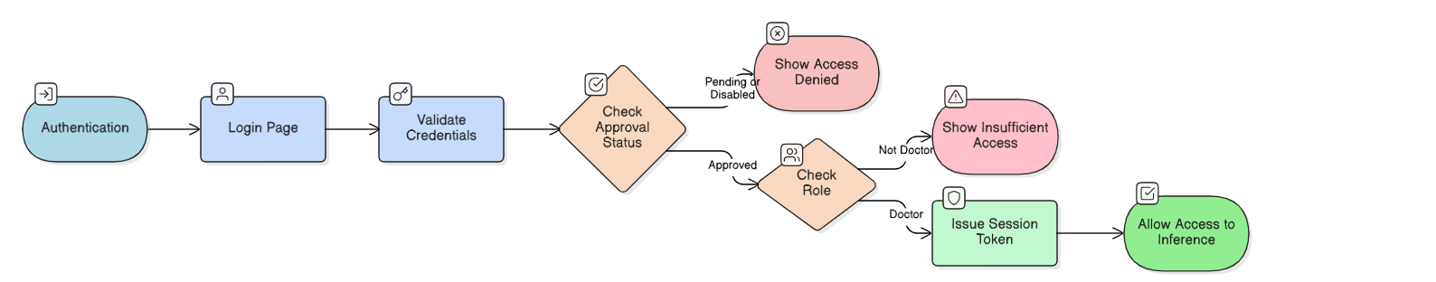
Flowchart

Slide 35
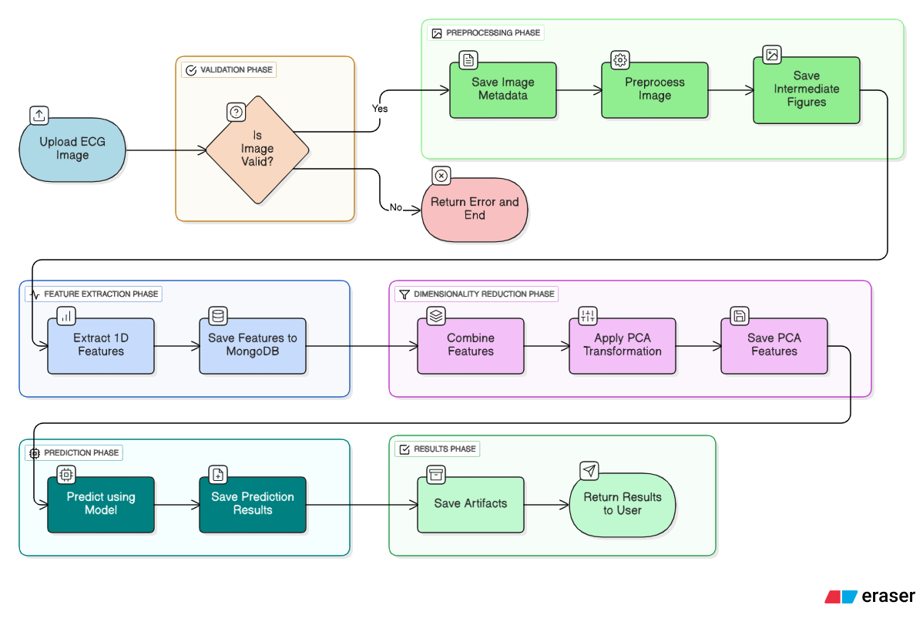
Flowchart

Slide 36

THANK YOU

